Slide 1
Who benefits from the GDP growth?
Kaloyan Haralampiev

Slide 2
Introduction
GDP per capita is actually average mean

Slide 3
Introduction
GDP per capita is actually average mean

Slide 4
Introduction
GDP per capita is actually average mean

Slide 5
Introduction
GDP per capita is actually average mean

Slide 6
Introduction
GDP per capita is actually average mean
However NSIs do not provide data for the variance/standard deviation because it is impossible to calculate it
On the other hand NSIs provide data for the income inequality

Slide 7
Data
Indicators:
GDP per capita, PPP (constant 2011 international $)
GINI index (World Bank estimate)
S80/S20
Source:
World Bank, International Comparison Program database.

Slide 8
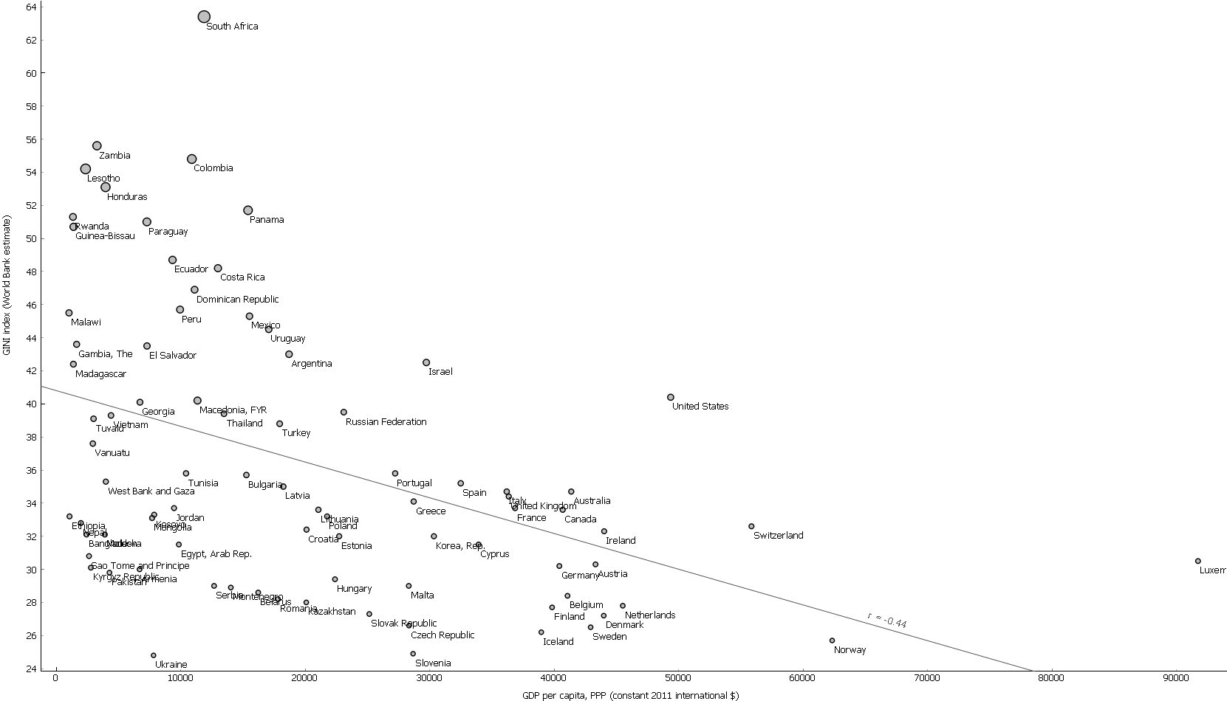
83 countries in the world (2010)

Slide 9
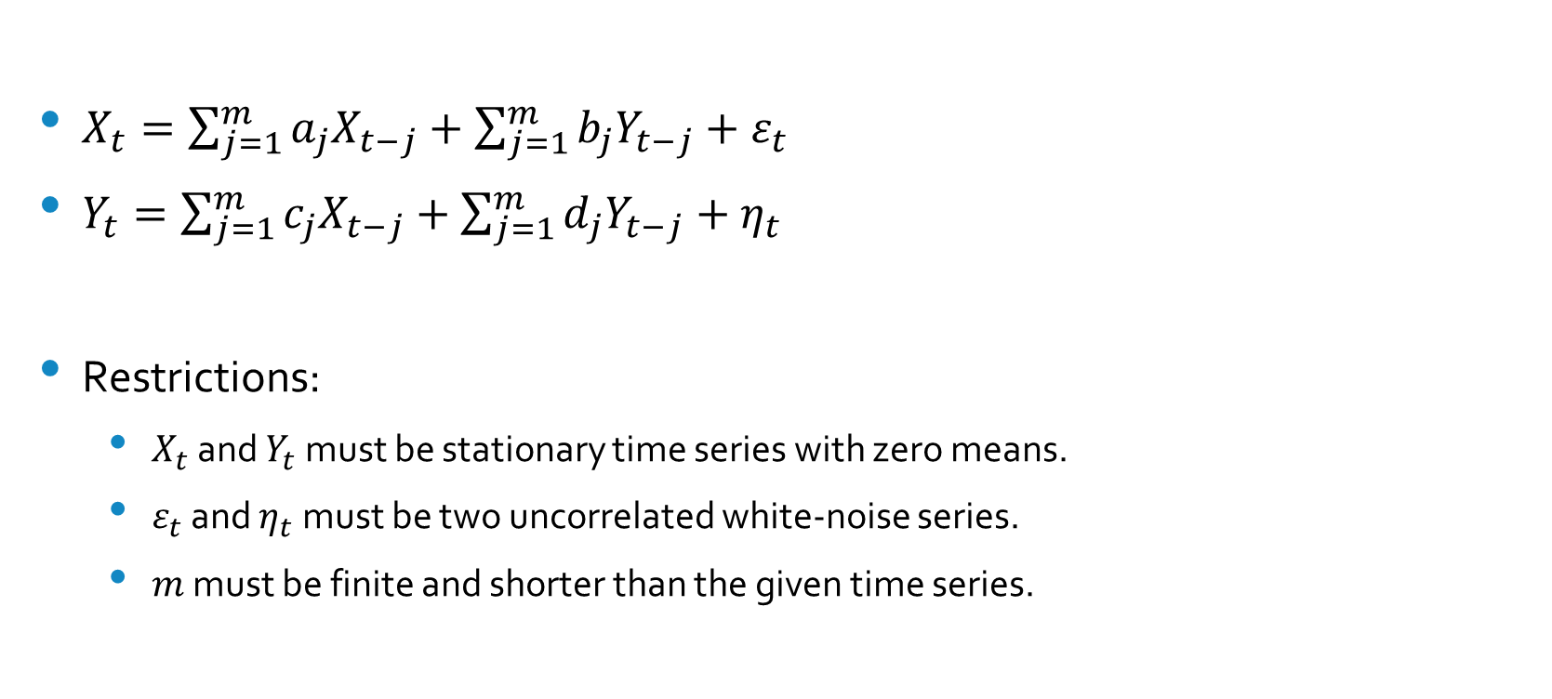
Granger’s simple causal two-variable model
$X_{t}=\sum_{j=1}^{m}{a_{j}X_{t−j}}+\sum_{j=1}^{m}{b_{j}Y_{t−j}}+ε_{t}$
$Y_{t}=\sum_{j=1}^{m}{c_{j}X_{t−j}}+\sum_{j=1}^{m}{d_{j}Y_{t−j}}+η_{t}$
Restrictions:
$X_{t}$ and $Y_{t}$ must be stationary time series with zero means.
$ε_{t}$ and $η_{t}$ must be two uncorrelated white-noise series.
$m$ must be finite and shorter than the given time series.

Slide 10
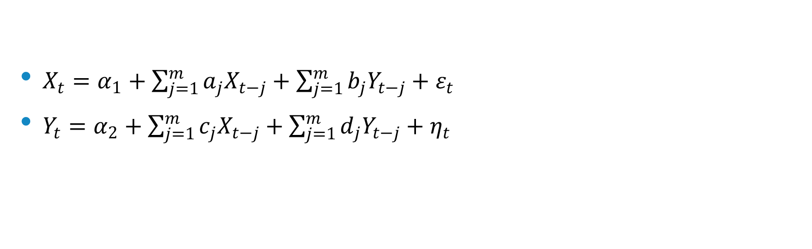
If the time series are stationary with non-zero means
$X_{t}=α_{1}+\sum_{j=1}^{m}{a_{j}X_{t−j}}+\sum_{j=1}^{m}{b_{j}Y_{t−j}}+ε_{t}$
$Y_{t}=α_{2}+\sum_{j=1}^{m}{c_{j}X_{t−j}}+\sum_{j=1}^{m}{d_{j}Y_{t−j}}+η_{t}$

Slide 11

In the case of non-stationarity
${∆X}_{t}=α_{1}+\sum_{j=1}^{m}{a_{j}∆X_{t−j}}+\sum_{j=1}^{m}{b_{j}∆Y_{t−j}}+ε_{t}$
${∆Y}_{t}=α_{2}+\sum_{j=1}^{m}{c_{j}∆X_{t−j}}+\sum_{j=1}^{m}{d_{j}∆Y_{t−j}}+η_{t}$

Slide 12
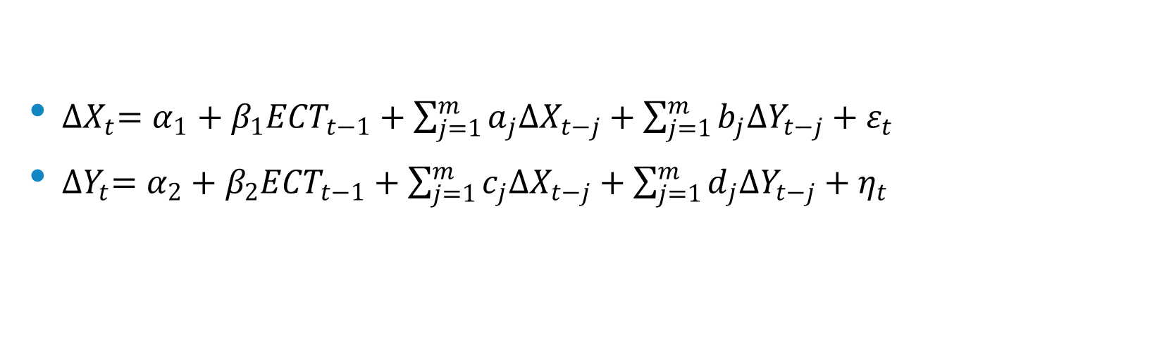
In the case of cointegration
${∆X}_{t}=α_{1}+β_{1}{ECT}_{t−1}+\sum_{j=1}^{m}{a_{j}∆X_{t−j}}+\sum_{j=1}^{m}{b_{j}∆Y_{t−j}}+ε_{t}$
${∆Y}_{t}=α_{2}+β_{2}{ECT}_{t−1}+\sum_{j=1}^{m}{c_{j}∆X_{t−j}}+\sum_{j=1}^{m}{d_{j}∆Y_{t−j}}+η_{t}$

Slide 13
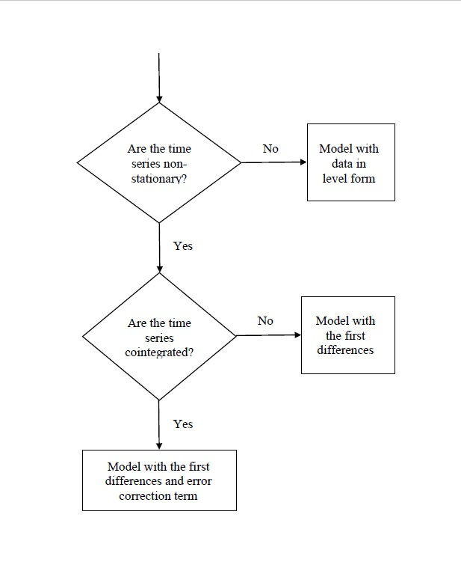
The algorithm

Slide 14
Panel data
Source:
World Bank, International Comparison Program database.
34 countries in the world
12 years period: 2003-2014

Slide 15
Im-Pesaran-Shin panel unit root test statistics
Variables | Deterministic | Level form |  | First-difference
 |  | Statistics | Probability | Statistics | Probability
GDP per capita, PPP (constant 2011 international $) | Individual intercept | -0.24 (1) | 0.403 | -6.75 (1) | 0.000
 | Individual intercept and trend | -0.61 (1) | 0.271 | -3.21 (1) | 0.001
GINI index (World Bank estimate) | Individual intercept | 0.08 (1) | 0.533 | -14.54 (1) | 0.000
 | Individual intercept and trend | -5.62 (1) | 0.000 | -8.99 (1) | 0.000
S80/S20 | Individual intercept | -0.87 (1) | 0.193 | -14.00 (1) | 0.000
 | Individual intercept and trend | -4.52 (1) | 0.000 | -9.75 (1) | 0.000

Slide 16
Johansen Fisher panel cointegration test statistics (based on individual intercept and trend)
Variable series | Hypothesised no. of CE(s) | Fisher statistics (from trace test) | Probability | Fisher statistics (from max-eigen test) | Probability
GDP and Gini | None | 298.9 | 0.000 | 252.5 | 0.000
 | At most 1 | 97.7 | 0.011 | 97.7 | 0.011
GDP and S80/S20 | None | 264.0 | 0.000 | 234.4 | 0.000
 | At most 1 | 97.4 | 0.011 | 97.4 | 0.011

Slide 17
VECM
Explanatory factors | Model 1: growth in GDP (ΔGDP) |  |  |  | Model 2: growth in Gini (ΔGini)
 | Coefficient | S.E. | t-value | Probability | Coefficient |  | S.E. | t-value | Probability
Constant | 214.802 | 59.193 | 3.63 | 0.000 | -0.316 |  | 0.079 | -4.00 | 0.000
1-year Lag of ΔGDP | 0.276 | 0.052 | 5.29 | 0.000 | 5.26x10⁻⁵ |  | 7.00x10⁻⁵ | 0.75 | 0.451
1-year Lag of ΔGini | -18.229 | 36.427 | -0.50 | 0.617 | -0.243 |  | 0.049 | -5.00 | 0.000
Long-run causality | -0.001 | 0.001 | -0.76 | 0.448 | -0.024 |  | 0.006 | -4.06 | 0.000
R-squared | 0.079 |  |  |  |  | 0.103
Adjusted R-squared | 0.071 |  |  |  |  | 0.095
Log likelihood | -2837.78 |  |  |  |  | -586.55
F-statistic | 9.60 |  |  |  |  | 12.82

Slide 18
VECM
Explanatory factors | Model 3: growth in GDP (ΔGDP) |  |  |  | Model 4: growth in S80/S20 (ΔS80/S20)
 | Coefficient | S.E. | t-value | Probability | Coefficient |  | S.E. | t-value | Probability
Constant | 218.462 | 59.390 | 3.68 | 0.000 | -0.177 |  | 0.055 | -3.24 | 0.001
1-year Lag of ΔGDP | 0.276 | 0.052 | 5.27 | 0.000 | -2.05x10⁻⁶ |  | 4.80x10⁻⁵ | -0.04 | 0.966
1-year Lag of ΔS80/S20 | -0.989 | 53.251 | -0.02 | 0.985 | -0.125 |  | 0.049 | -2.56 | 0.011
Long-run causality | -1.84x10⁻⁶ | 3.10x10⁻⁶ | -0.59 | 0.552 | -0.070 |  | 0.011 | -6.55 | 0.000
R-squared | 0.077 |  |  |  |  | 0.119
Adjusted R-squared | 0.069 |  |  |  |  | 0.111
Log likelihood | -2838.05 |  |  |  |  | -460.72
F-statistic | 9.41 |  |  |  |  | 15.09

Slide 19
A summary of the causal relationships and direction between the two series
Null hypothesis | Short-run χ2-statistics | Long-run t statistics (ECT) | Long-run χ2-statistics (strong Granger causality)
ΔGini does not cause ΔGDP | 0.25 | -0.76 | 0.91
ΔGDP does not cause ΔGini | 0.57 | -4.06* | 16.97*
ΔS80/S20 does not cause ΔGDP | 0.00 | -0.59 | 0.37
ΔGDP does not cause ΔS80/S20 | 0.00 | -6.55* | 42.92*

Slide 20
And finally: who benefits from the GDP growth?

Slide 21
Thank you!

Slide 22
Absolute equality

Slide 23
Absolute inequality

Slide 24
“Exponential” inequality

Slide 25
“Socialist” inequality

